Slide 1
Introduction to Digital Image Processing

Slide 2
What is Digital Image Processing?
Processing of images which are digital in nature by a digital camera.

Slide 3
Why do we need Image Processing?
Improvement of pictorial information for human perception.
Image processing for autonomous machine application.
Efficient storage and transmission.

Slide 4
Human perception
Employ methods capable of enhancing pictorial information for human perception and analysis
Typical applications:
Noise filtering
Content enhancement
Contrast enhancement
Deblurring
Remote Sensing

Slide 5
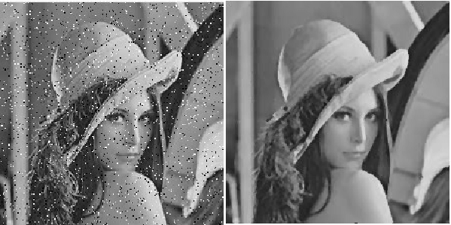
a) Before
b) After
Fig: Noise Filtering

Slide 6
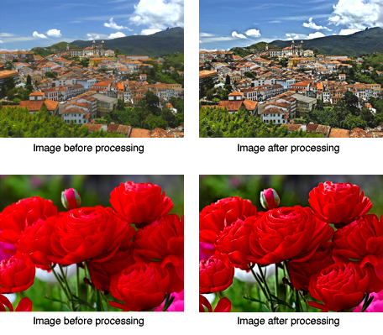
Fig: Contrast Enhancement

Slide 7
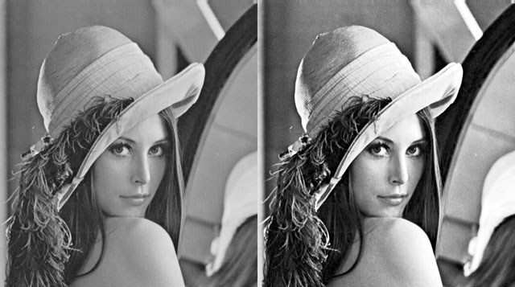
Fig: Contrast Enhancement

Slide 8
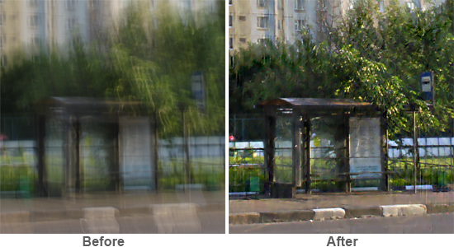
Fig: Deblurring

Slide 9
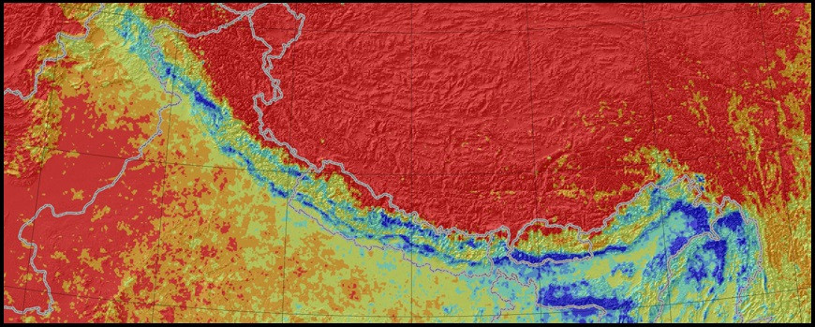
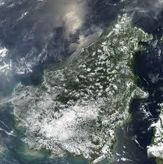
a) Earth’s terrain info
b) Smoke formation from fire
Fig: Remote Sensing Applications

Slide 10
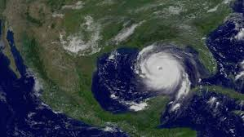
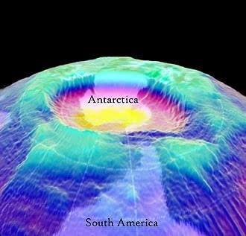
Fig: Hurricane Formation
Fig: Ozone Hole formation

Slide 11
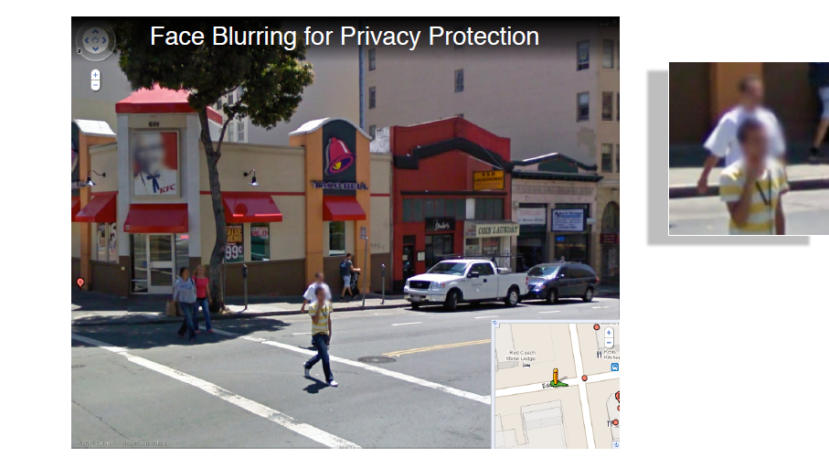

Slide 12
Machine Vision Applications
Here the interest is on procedures for extraction of image information suitable for computer processing.
Typical applications:
Industrial Machine vision for product assembly and inspection.
Automated Target detection and tracking
Finger print recognition.
Machine processing of aerial and satellite imagery for weather prediction and crop assessment, etc

Slide 13
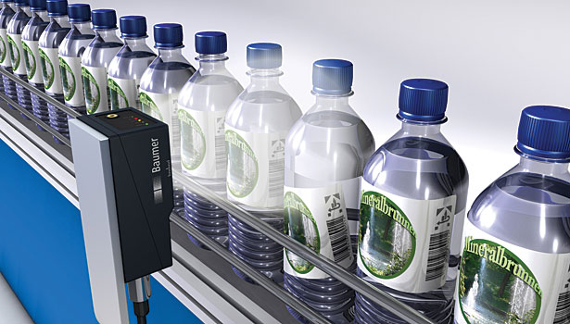
Fig: Vision sensors implemented in a bottling plant

Slide 14
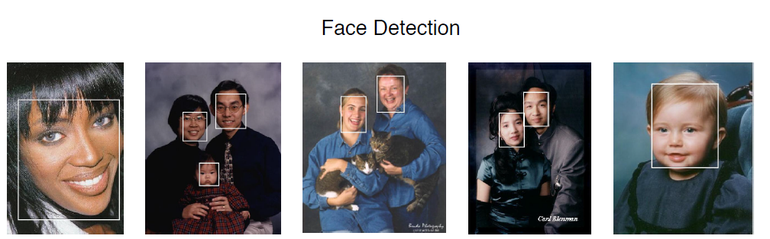

Slide 15
Video Sequencing Processing
The major emphasis of image sequence processing is detection of moving parts.
This has various applications:
Detection and tracking of moving targets for security surveillance purpose.
To find out the trajectory of a moving target.
Monitoring the organ boundaries in medical applications, etc.

Slide 16
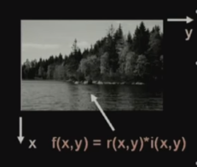
Image Representation
An image is a 2-D light intensity function f(x,y)
A digitized image f(x,y) is discretized both in spatial coordinates and brightness.
It can be considered as a matrix whose row, column indices specify a point in the image and the element value identifies gray level value at that point.
These elements are referred to as pixels or pels or picture elements.

Slide 17
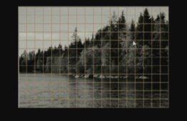
Spatial discretization by grids
Intensity discretization by quantization

Slide 18
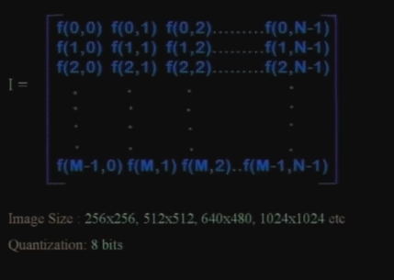
Image Representation

Slide 19
Steps in Digital Image Processing
Digital Image Processing involves following basic tasks:
Image Acquisition:- An imaging sensor and the capability to digitize the signal produced by the sensor.
Preprocessing:- Enhances the image quality, filtering, contrast enhancement, etc.
Segmentation:- Partition an input image into constituent parts of objects.

Slide 20
Description/Feature selection:- Extracts description of image objects suitable for further computer processing.
Recognition & Interpretation:- Assigning a label to the object based on the information provided by its descriptor. Interpretation assigns meaning to a set of labeled objects.

Slide 21
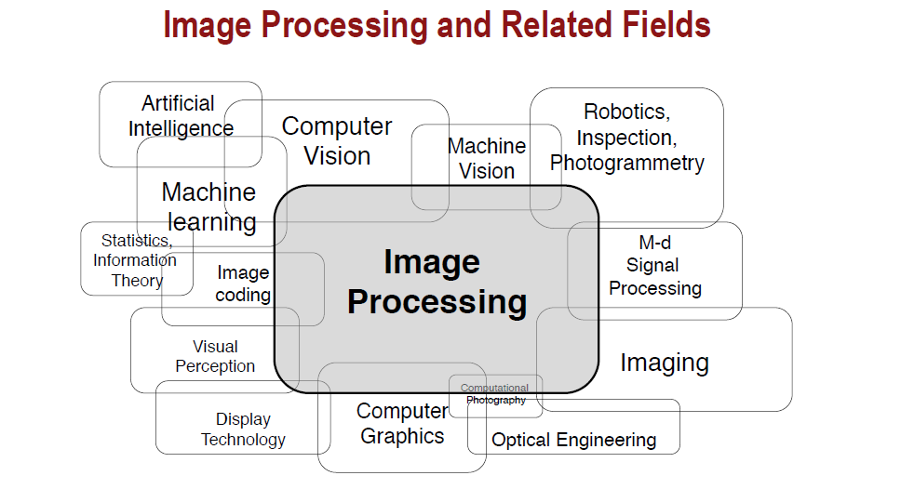

Slide 22
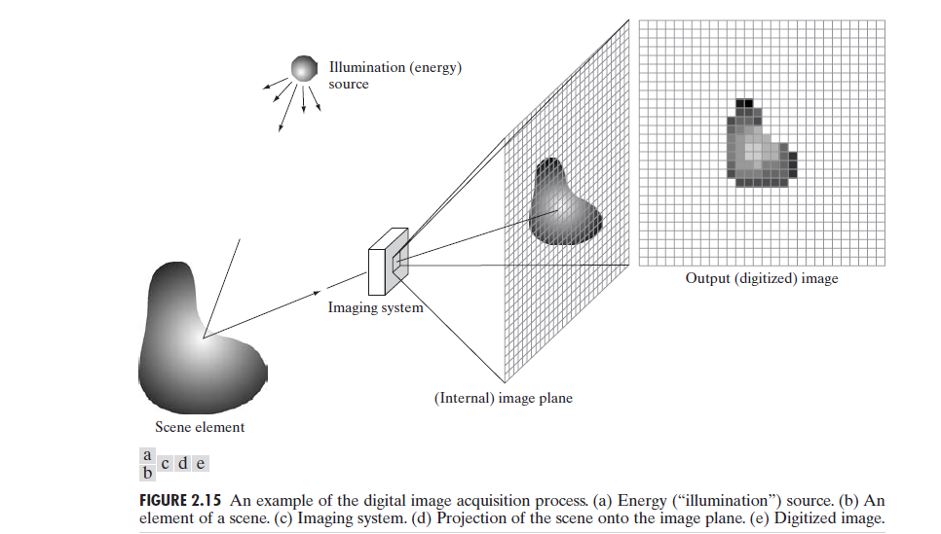
A simple image formation model

Slide 23
Digital images are denoted by two-dimensional functions of the form f(x,y).
f denotes the intensity value or amplitude at spatial coordinates (x,y), which is a positive scalar quantity.
The intensity values are proportional to energy radiated by a physical source.
Therefore, f(x,y) must be nonzero and finite
i.e., 0< f(x,y) < ∞

Slide 24
f(x,y) is characterized by two components
1. the amount of source of illumination incident on the scene being viewed (illumination, denoted by i(x,y))
2. the amount of illumination reflected by the objects in the scene (reflectance, denoted by r(x,y))
f(x,y) = i(x,y) * r(x,y)
where, 0 < i(x,y) < ∞
and 0 < r(x,y) < 1
Here, 0 represents total absorption
1 represents total reflectance

Slide 25
The nature of i(x,y) is determined by the illumination source, and r(x,y) is determined by the characteristics of the imaged objects.
The interval [Lmin, Lmax] is called the gray(or intensity) scale.
l is the intensity (gray level) at any coordinates (x₀ ,y₀)
l =f (x₀ ,y₀)
Common practice is to shift this interval numerically to the interval [0,L-1], where l=0 is considered and l = L-1 is considered white on the gray scale.
All intermediate values are shades of gray varying from black to white.

Slide 26
Image Sampling and Quantization
The output of most sensors is a continuous voltage waveform whose amplitude and spatial behavior are related to the physical phenomenon being sensed.
To create a digital image, we need to convert the continuous sensed data into digital form.
This involves two processes:
Sampling
Quantization

Slide 27
Digitizing the coordinate values is called sampling.
Digitizing the amplitude values is called quantization.

Slide 28
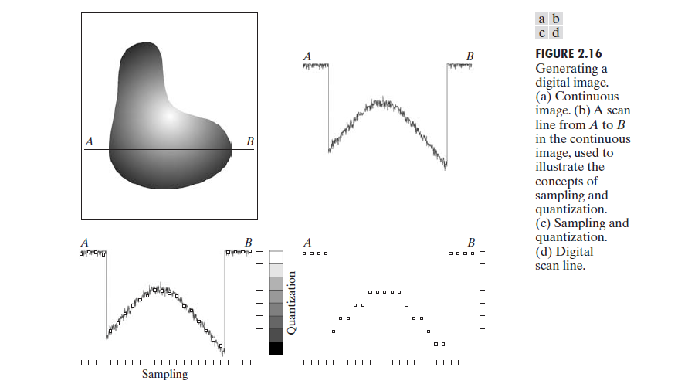

Slide 29
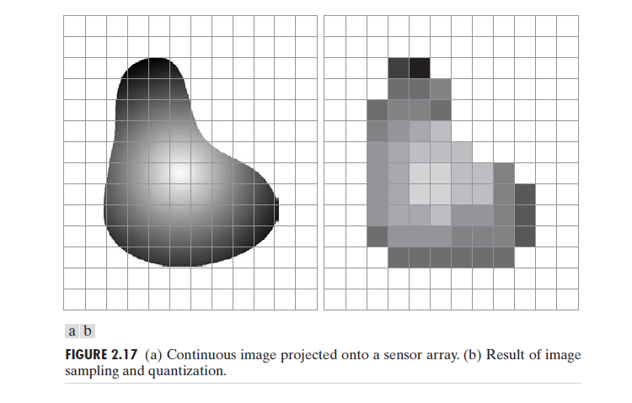

Slide 30
Representing Digital Images
The section of the real plane spanned by the coordinates of an image is called the spatial domain, with x and y being referred to as spatial variables or spatial coordinates.

Slide 31
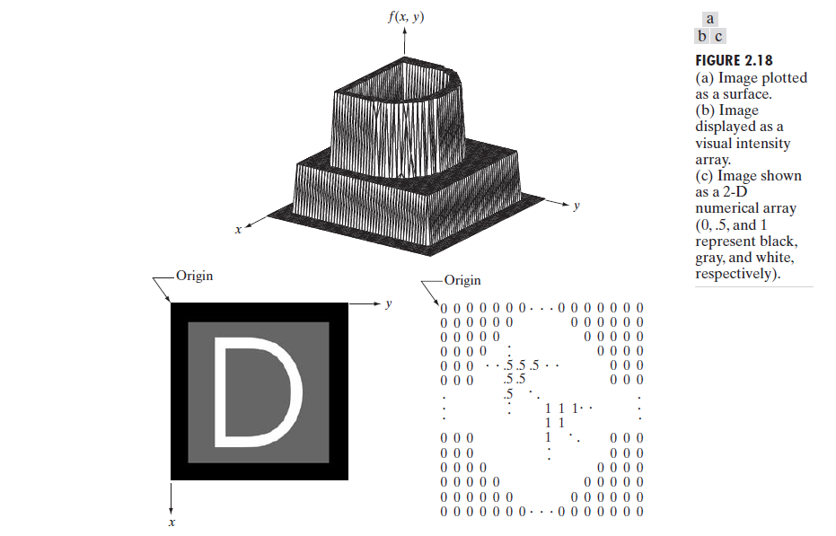

Slide 32
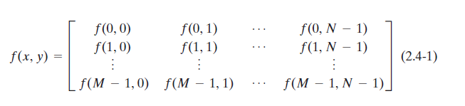
In equation form, we write the representation of an M*N numerical array as
The number of intensity levels typically is an integer power of 2:
L = 2^{k}
The dynamic range of an imaging system to be the ratio of the maximum measurable intensity to the minimum detectable intensity level in the system.

Slide 33
Image contrast is defined as the difference in intensity between the highest and lowest intensity levels in an image.
When an appreciable number of pixels in an image have a high dynamic range, we can expect the image to have high contrast. Conversely, an image with low dynamic range typically has a dull, washed-out gray look.
The number, b, of bits required to store a digitized image is
b = M * N * k
When M=N, this equation becomes
b=N²K

Slide 34
Spatial Intensity and resolution
Spatial resolution is a measure of the smallest discernible detail in an image.
Intensity resolution or Gray-Level resolution refers to the smallest discernible change in intensity or gray level.

Slide 35
Some basic relationships of a pixel
Neighbors of a pixel: A pixel p at coordinates (x,y) has four horizontal and vertical neighbors whose coordinates are given by
(x+1,y), (x-1,y), (x,y+1), (x,y-1)
They are called 4-neighbors of p and denoted by N₄(p).
Each pixel is a unit distance from (x,y).

Slide 36
The four diagonal neighbors of p have coordinates
(x+1, y+1), (x+1, y-1), (x-1, y+1), (x-1, y-1)
They are denoted by N_{D}(p).
N₄(p) U N_{D}(p) form the eight neighbors of the pixels and is represented by N₈(p).

Slide 37
Adjacency:
Let V be the set of intensity values used to define adjacency.
In a binary image, V={1} if we are referring to adjacency of pixels with value 1.
Types of adjacency:
4-adjacency: Two pixels p and q with values from V are 4-adjacent if q is in the set N₄(p).
8-adjacency: Two pixels p and q with values from V are 8-adjacent if q is in the set N₈(p).
M-adjacency(mixed adjacency): Two pixels p and q with values from V are m-adjacent if
q is in N₄(p), or
q is in N_{D}(p) and the set N₄(p) ∩ N₄(q) has no pixels whose values are from V.

Slide 38
Let S represent a subset of pixels in an image.
Two pixels p and q are said to be connected in S if there exists a path between them consisting entirely of pixels in S.
For any pixel p in S, the set of pixels that are connected to it in S is called a connected component of S.
If it only has one connected component, then set S is called a connected set.

Slide 39
Let R be a subset of pixels in an image.
We call R a region of the image if R is a connected set.
The boundary( also called border or contour) of a region R is the set of pixels in the region that have one or more neighbors that are not in R.

Slide 40
A digital path (or curve) from pixel p with coordinates (x,y) to pixel q with coordinates (s,t) is a sequence of distinct pixels with coordinates
(x₀ ,y₀), (x₁ ,y₁), ……, (x_{m} ,y_{n})
where (x₀ ,y₀) =(x,y), (x_{m} ,y_{n})= (s,t) and (x_{i}-1, y_{i}-1) are adjacent for 1<= i<=n.
n is the length of the path.
If (x₀ ,y₀)= (x_{m} ,y_{n}), the path is a closed path.

Slide 41
Distance Measures: For pixels p, q and z with coordinates (x,y), (s,t), and (v,w), respectively, D is a distance function or metric if
D(p,q) >= 0, (D(p,q)=0 iff p=q)
D(p,q) = D(q,p) and
D(p,z) <= D(p,q) + D(q,z)
The Euclidean distance between p and q is defined as
D_{e} (p,q) =[(x-s)² + (y-t)²] ^{½}
The D₄ distance (also called city-block distance) between p and q is defined as
D₄ (p,q) = |x-s| + |y-t|

Slide 42
Image enhancement
Objective: To process an image so that the result is more suitable than the original image for a specific application.
Specific because the techniques applied are problem oriented.
Image enhancement approaches falls into two broad categories:
Spatial Domain
Frequency Domain

Slide 43
Spatial domain refers to the image plane itself, and approaches in this category are based on direct manipulation of pixels In an image.
Frequency domain processing techniques are based on modifying the Fourier transform of an image.

Slide 44
Spatial Domain
Spatial domain methods are procedures that operate directly on the pixels.
The process will be denoted by the expression
g( x,y) = T[ f(x,y)]
Where f(x,y) is the input image, g(x,y) is the processed image , and T is an operator on f, defined over some neighborhood of (x,y).

Slide 45
The principal approach in defining a neighborhood about a point (x,y) is to use a square or rectangle sub image area centered at (x,y).
The center of the sub image is moved from pixel to pixel starting, say, at the top left corner.
The operation T is applied at each location (x,y) to yield the output, g, at that location.

Slide 46
The simplest form of T is when the neighborhood is of size 1*1 .
In this case, g depends only on the value of f at (x,y), and T becomes a gray-level (also called an intensity or mapping) transformation function of the form
s=T(r)
Where, r denotes the gray level of f(x,y)
s denotes the gray level of g(x,y)
Because enhancement at any point in an image depends only on the gray level at that point, techniques in this category often referred to as point processing.

Slide 47
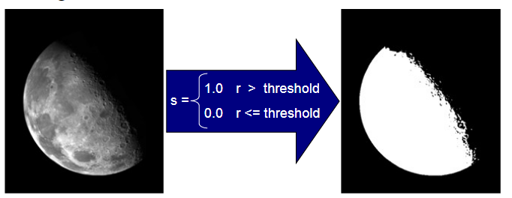
Point Processing Example: Thresholding
Thresholding transformations are particularly useful for segmentation in which we want to isolate an object of interest from a background.

Slide 48
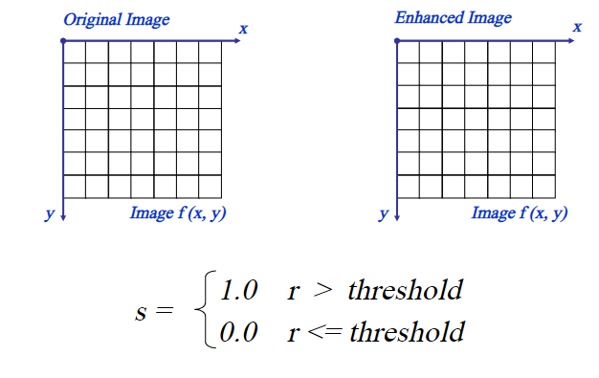

Slide 49
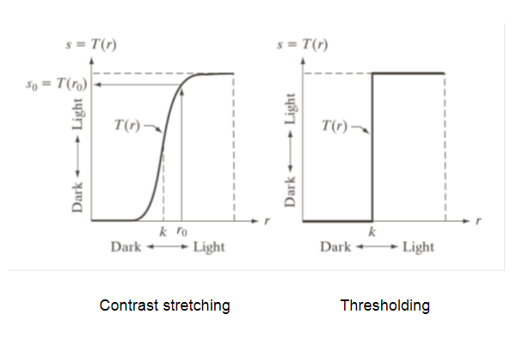

Slide 50
Mask Processing or Filtering:
When the processing on a pixel involves the values of its neighborhood we use the concept of masks ( also referred to as filters, kernels, templates, or windows).
A mask can be a size of 3*3 2-D array in which the mask coefficients determine the nature of the process, such as image sharpening.
General approach is to use a function of the values of f in a predefined neighborhood of (x,y) to determine the value of g at (x,y).

Slide 51
Some basic gray level transformations
Three types of functions used frequently for image enhancement:
Linear( negative and identity transformations)
Logarithmic( log and inverse transformations)
Power-law (nth power and nth root transformations)

Slide 52
Image Negatives:
The negative of an image with gray levels in the range [0,L-1] is obtained by using the negative transformation, which is given by the expression
s=L-1-r
Reversing the intensity levels of an image in this manner produces the equivalent of a photographic negative.
This type of processing is particularly suited for enhancing white or gray detail embedded in dark regions of an image, especially when the black areas are dominant in size.

Slide 53
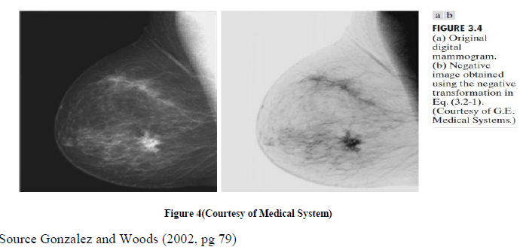

Slide 54
Log Transformations:
The general form of the log transformation is
s= c log(1+r)
Where, c is a constant
we assume that r>=0
The log transformation maps a narrow range of low gray-level values in the input image into a wider range of output levels.
The inverse log transformation performs the opposite transformation.

Slide 55
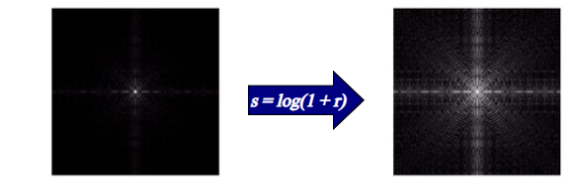
We use a transformation of this type to expand the values of dark pixels in an image while compressing the higher-level values.
In the following example, the Fourier transform of an image is put through a log transform to reveal more detail.

Slide 56
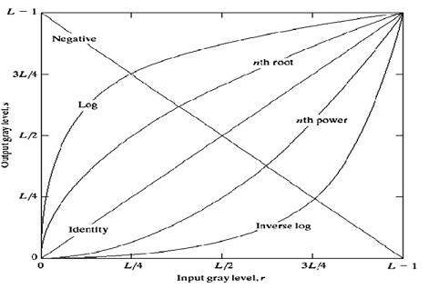

Slide 57
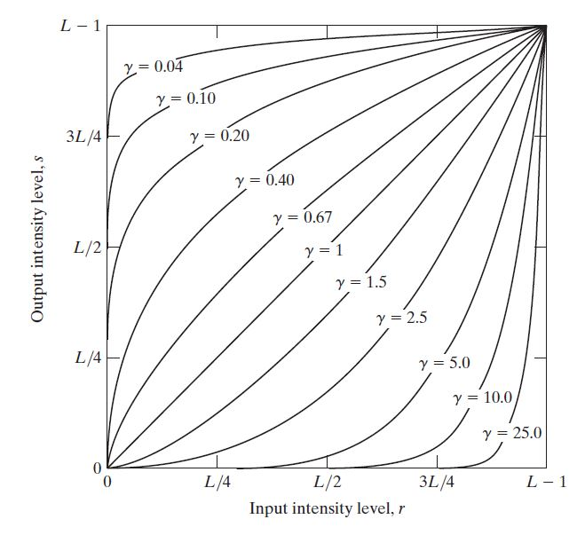
Power-Law Transformations
Power-law transformations have the basic form
s =cr^{γ} …..........(1)
Where c and γ are positive constants.
Maps a narrow range of dark input values into a wider range of output values or vive versa.
Varying γ gives a whole family of curves.

Slide 58
A variety of devices used for image capture, printing, and display respond according to a power law.
By convention, the exponent in the power-law equation is referred to as gamma.
The process to correct this power-law response is called gamma correction.
Example – Cathode Ray Tube(CRT) devices have an intensity –to-voltage response that is a power function

Slide 59
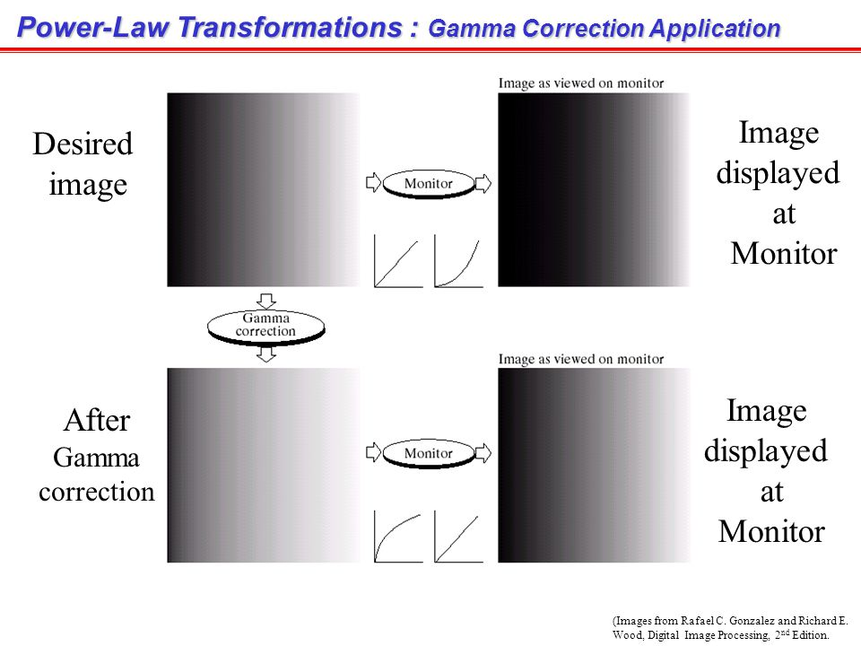

Slide 60
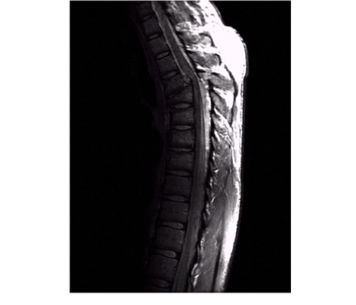
Power-Law transformations are useful for general-purpose contrast manipulation…
Example:

Slide 61
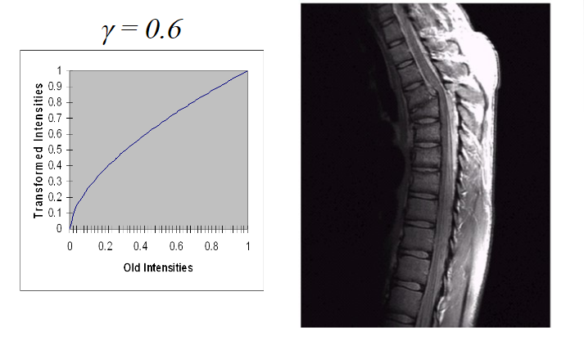

Slide 62
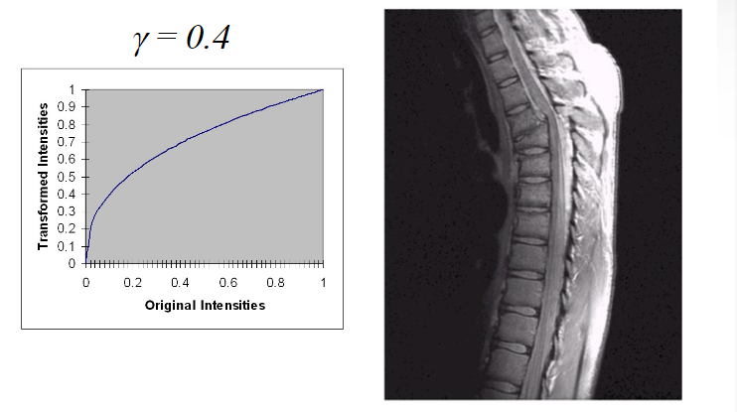

Slide 63
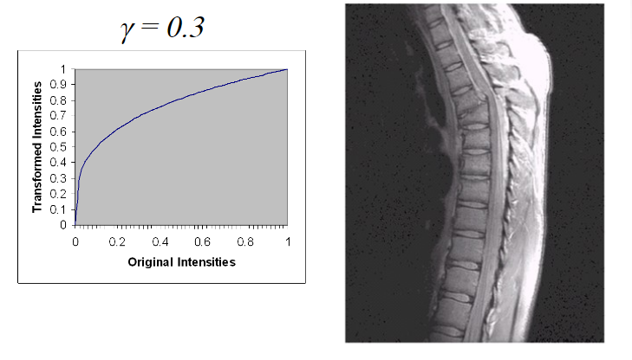

Slide 64
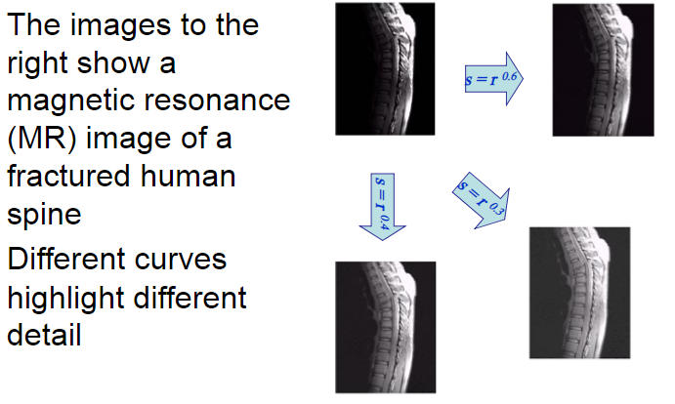

Slide 65
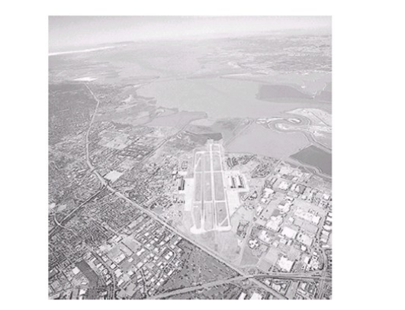

Slide 66
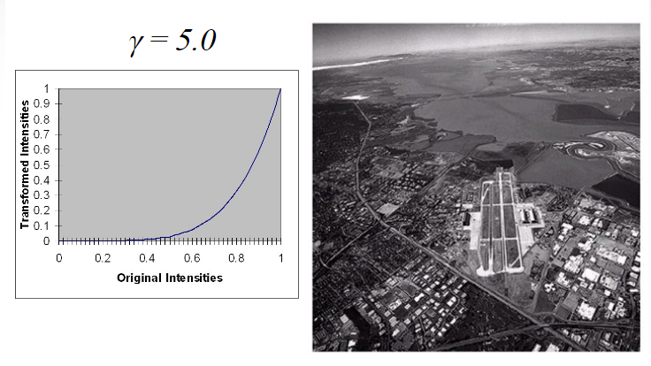

Slide 67
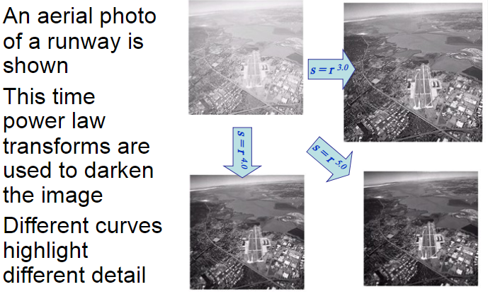

Slide 68
Piecewise-Linear Transformation functions
Contrast Stretching:
It is a process that expends the range of intensity levels in an image so that it spans the full intensity range of the recording medium or display device.

Slide 69
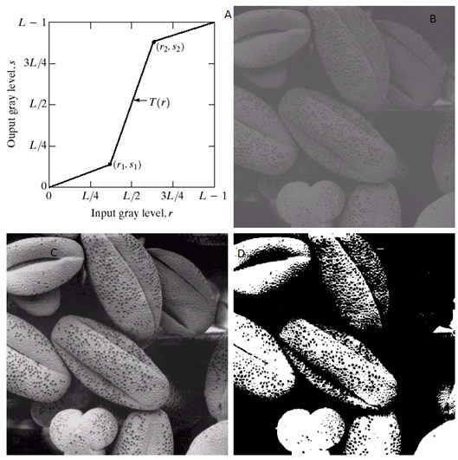

Slide 70
Gray-Level Slicing
Highlighting a specific of gray levels in an image
Applications:
Enhancing features such as masses of water in satellite imagery and enhancing flaws in X-ray images.
Two ways of doing gray-level slicing:
Display a high value for all grey levels in the range of interest and a low value for all other grey levels.
This produces a binary image.
Brighten the desired range of gray levels but preserve the background and gray-level tonalities in the image.

Slide 71
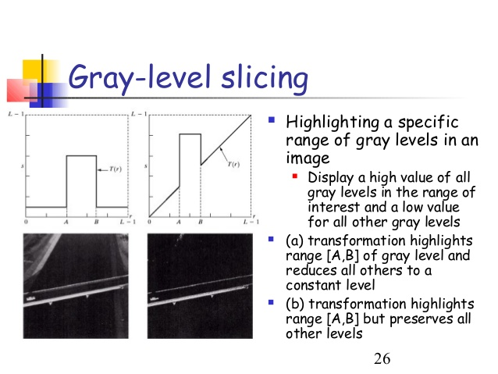

Slide 72
Bit-plane Slicing:
Here, instead of highlighting the grey-level changes, highlighting the contribution made to total image appearance by specific bits is done.
Pixels are digital numbers composed of bits.
Eg., For an 8-bit image, the image is composed of eight 1-bit planes, ranging from bit-plane 0 for the least significant bit to bit-plane 7 for the most significant bit.
Plane 0 contains all the lowest order bits in the bytes comprising the pixels in the image and plane 7 contains all the higher-order bits.

Slide 73
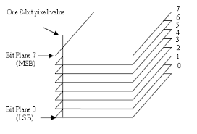
BIT- Plane slicing PIC!!!!

Slide 74
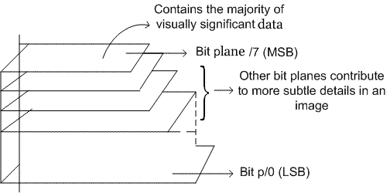

Slide 75
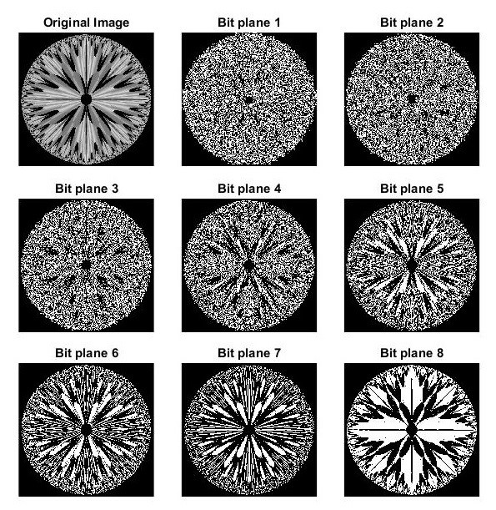

Slide 76
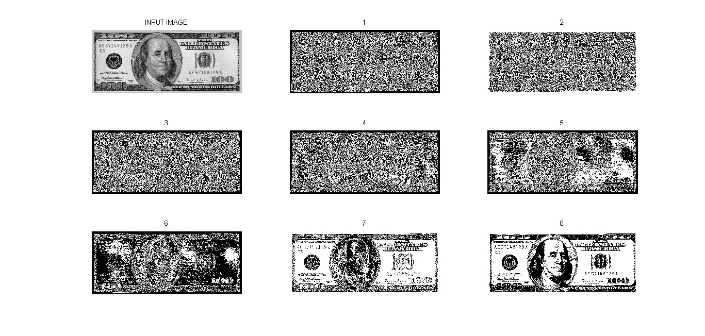

Slide 77
In the example, we observe that the higher-order bits (especially the top four) contain the majority of the visually significant data.
The other bit planes contribute to more subtle details in the image.
This type of decomposition is useful for image compression.

Slide 78
Histogram PRocessing
Histogram is the graphical representation of the frequency of occurrence of grey levels in an image.
Histograms are the basis for numerous spatial domain processing techniques.
Histogram manipulation can be used effectively for image enhancement.
The histogram of a digital image with gray levels in the range [0,L-1] is a discrete function h(r_{k}) =n_{k}
where r_{k} is the k^{th} gray level
n_{k} is the number of pixels in the image having gray level r_{k}

Slide 79
Normalization is done by dividing each of its values by the total number of pixels in the image, denoted by n.
Thus, a normalized histogram is given by p(r_{k}) = n_{k}/n, for k=0,1,…., L-1
Loosely speaking, p(r_{k}) gives an estimate of the probability of occurrence of gray level r_{k}
The sum of all components of the normalized histogram is equal to 1.

Slide 80
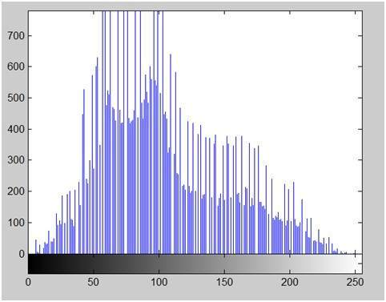
HISTOGRAM IMAGE!!!!!!

Slide 81
Histogram equalization
Consider the transformations of the form
s=T(r) 0<=r<=1
that produce a level s for every pixel value r in the original image.
We assume that the transformation function T(r) satisfies the following conditions:
T(r) is single-valued and monotonically increasing in the interval 0<=r <=1; and
0<= T(r) <=1 for 0<=r<=1

Slide 82
The requirement in (a) that T(r) be single valued is needed to guarantee that the inverse transformation will exist.
And the monotonicity condition preserves the increasing order from black to white in the output image.
A transformation function not monotonically increasing could result in at least a section of the intensity being inverted, thus producing some inverted gray levels in the output image.

Slide 83
Condition (b) guarantees that the output fray levels will be in the same range as in the input levels.
The inverse transformation from s back to r is denoted by
r = T⁻¹ (s) 0 <= s <=1
Graph!!!

Slide 84
Image Interpolation
Interpolation is the process of using known data to estimate values at unknown locations.
Interpolation is usually used for image resizing( shrinking and zooming)

Slide 85
Explainable model required for domain experts…not for normal lay users.
Inter disciplinary?

Slide 86
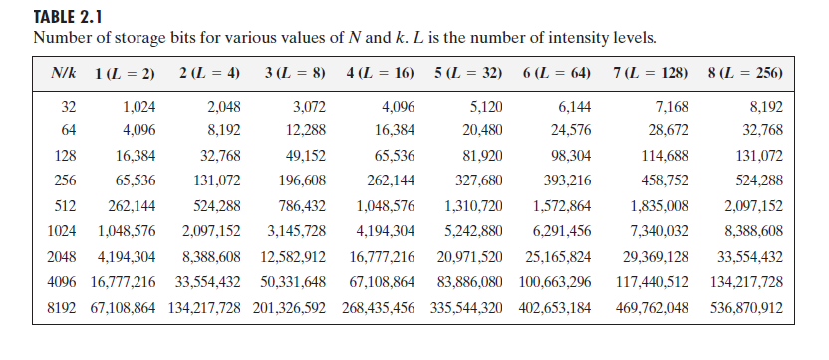

Slide 87
Linear and non-linear operations
Let H be an operator whose input and output are images.
H is said to be a linear operator if, for any two images f and g and any two scalars a and b,
H(af+bg) = aH(f) + bH(g)
i.e., the result of applying a linear operator to the sum of two images (that have been multiplied by constants shown) is identical to applying the operator to the images individually, multiplying these results by the appropriate constants, and than adding those results.

